Slide 1
Sales and Profits Conundrum

Slide 2
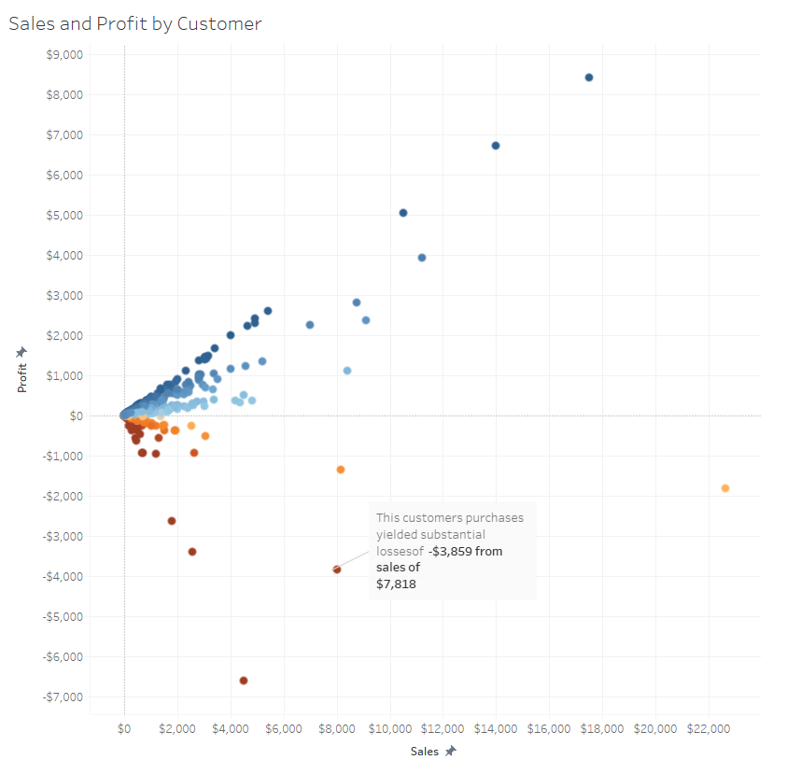
What’s the problem?
Most customers earn us a profit, but there are customers who have a “lot” of sales yet, the profit is a loss!
WHY?

Slide 3
Three Possibilities: Do any of these show a pattern?
Geography
Type of Products
Discounts

Slide 4
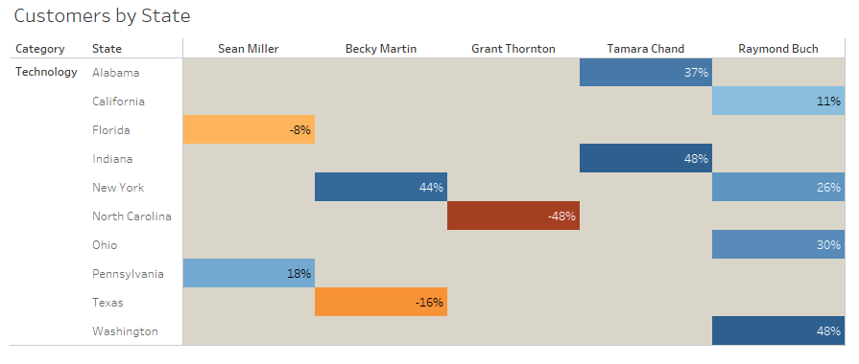
It’s not geography

Slide 5
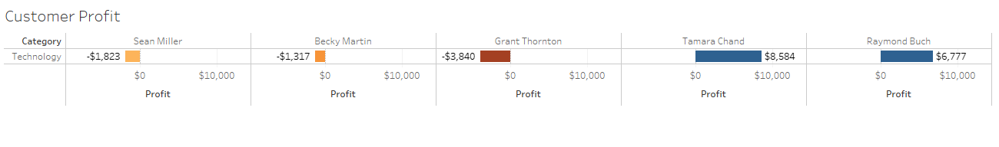
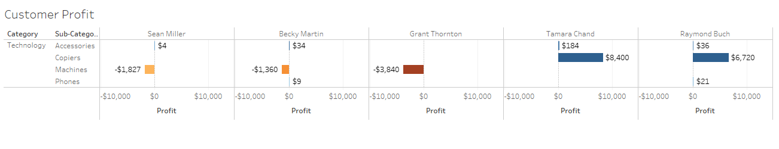
Yes, It’s the type of products, but it’s not the category

Slide 6
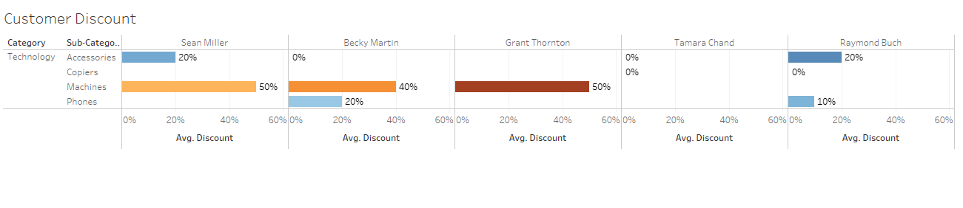
Yes, It’s the level of discounts

Slide 7
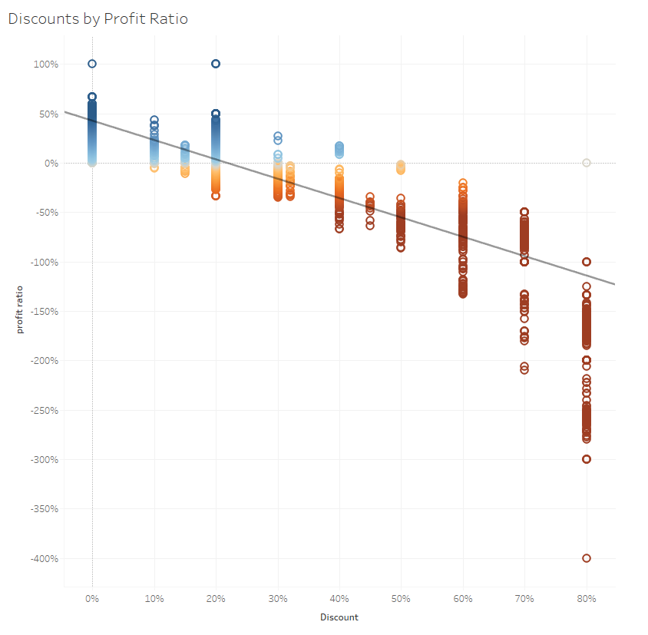
Profits and discounts

Slide 8
Conclusion and Recommendation
Sales by state may have outliers but there doesn’t seem to be a pattern. Therefor, I recommend not studying Geography as a reason for losses in the first round.
Accessories and phones are profitable, machines are not. Consider the sales of machines in the future.
Higher Discounts led to losses. So, Consider discounts not exceed 20- 30% as shown by data.

